Slide 1
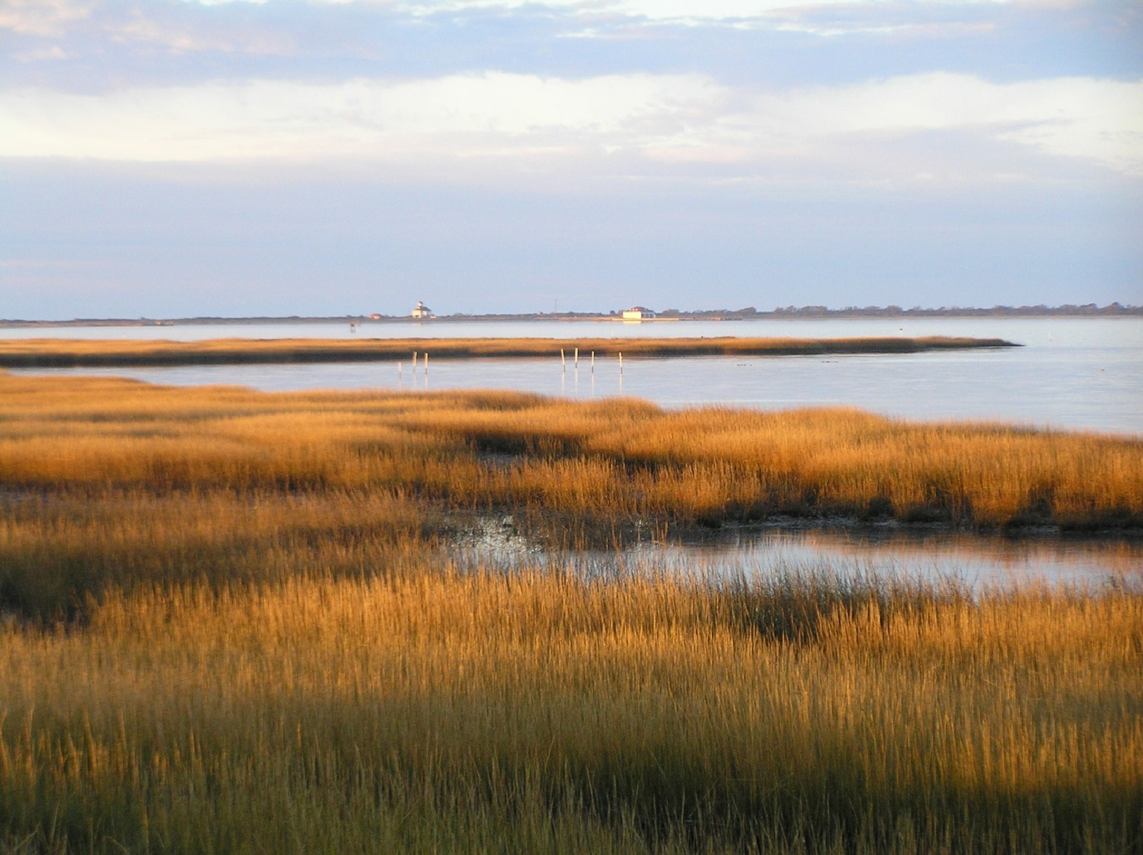



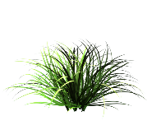
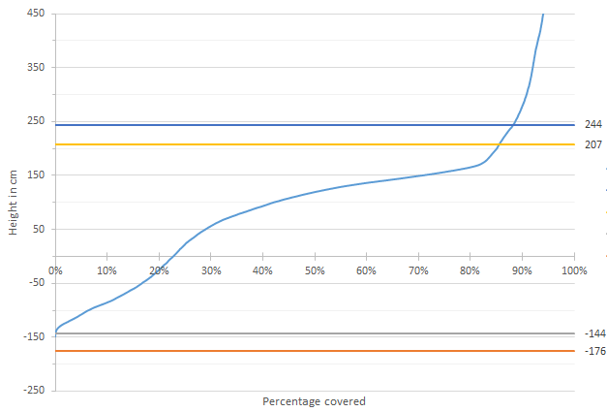
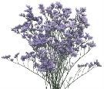
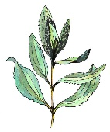
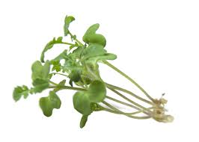

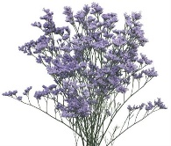
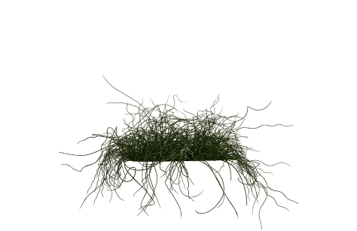
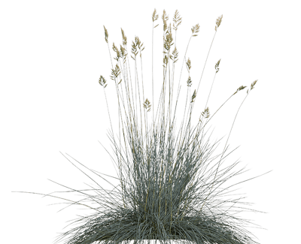
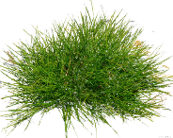
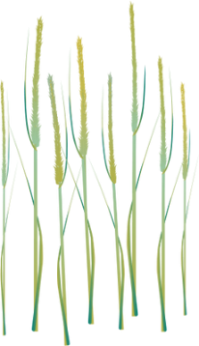
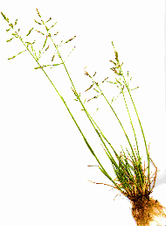
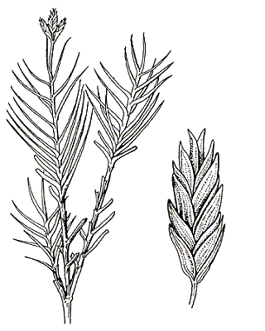
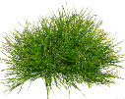
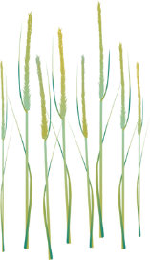
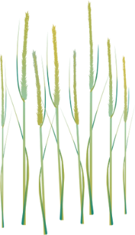
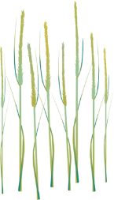
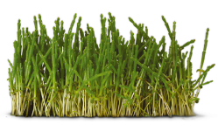
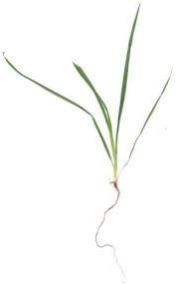


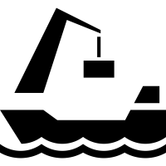
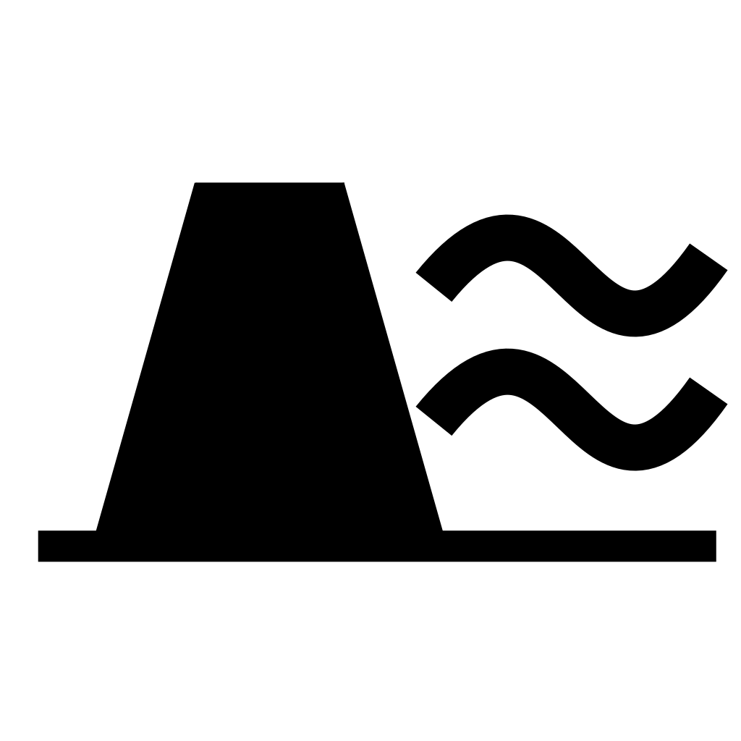
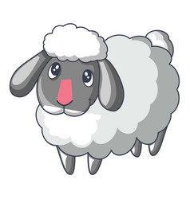
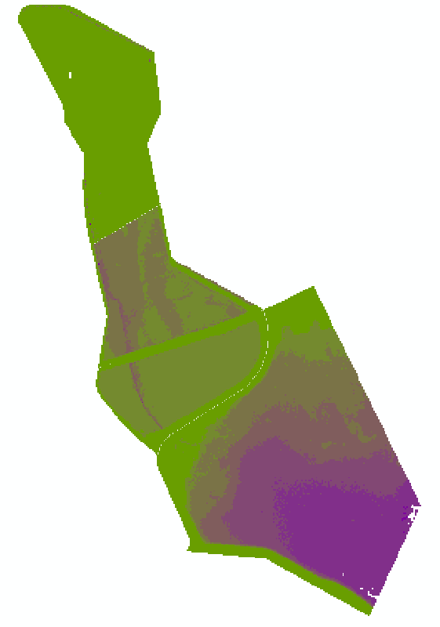
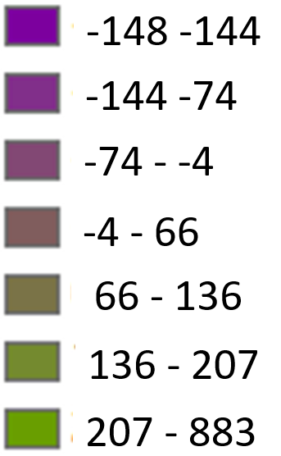
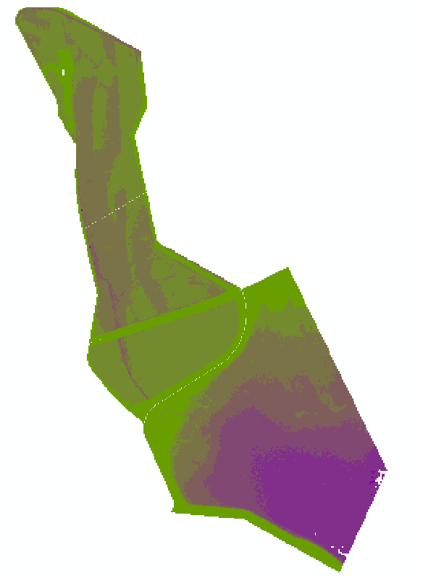
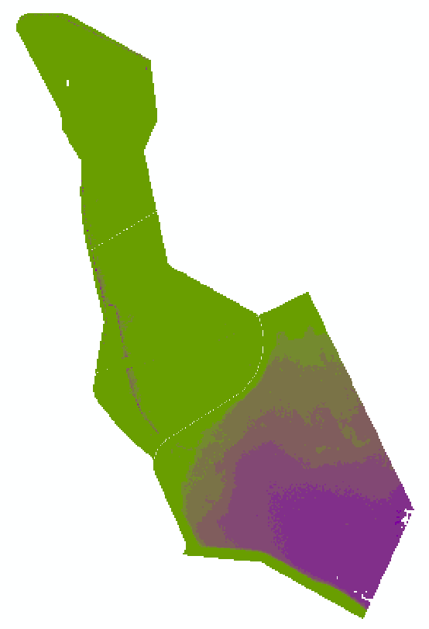
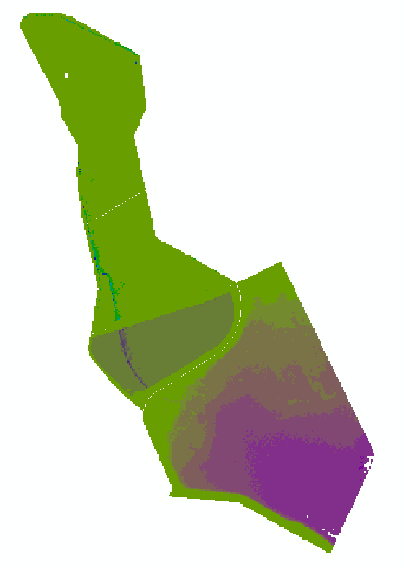

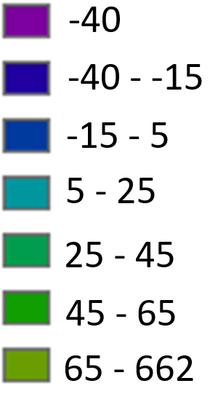
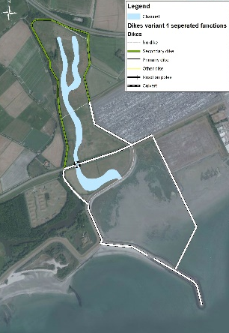
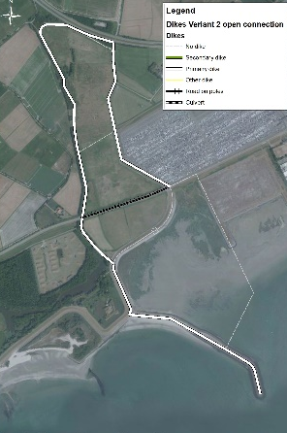
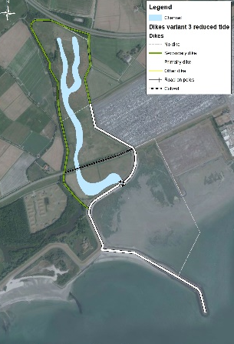
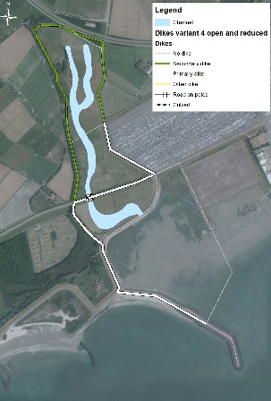
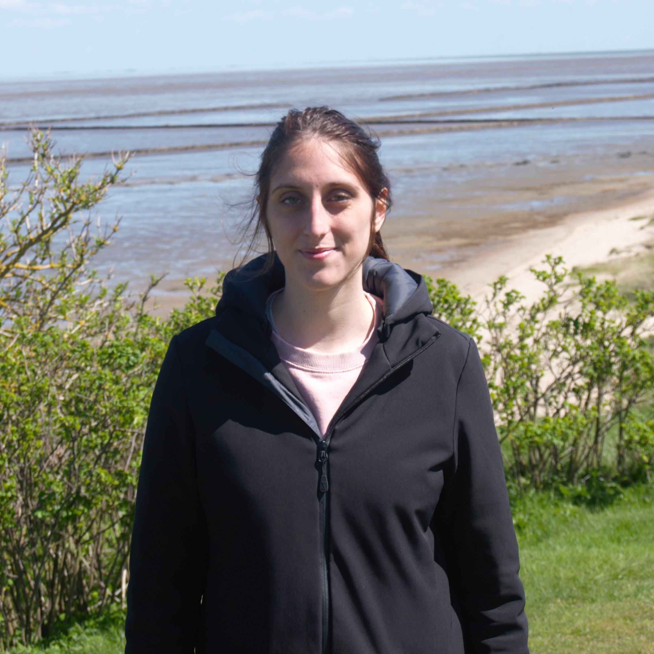
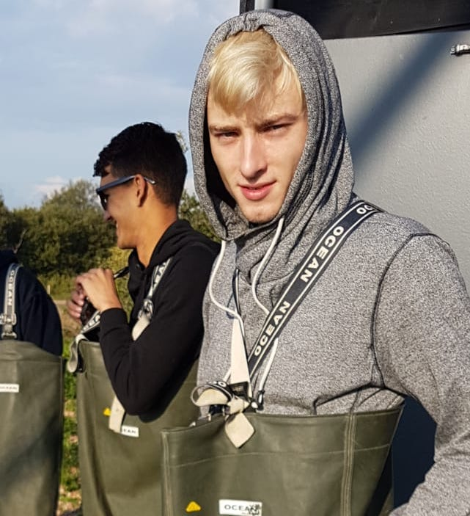
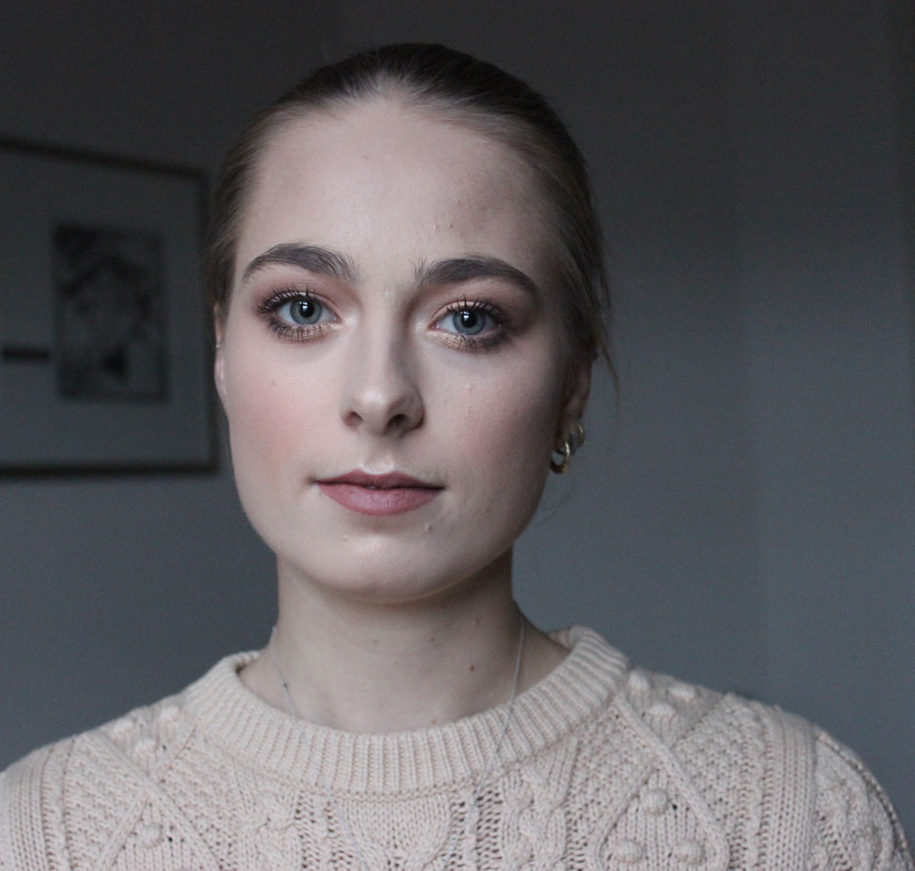


THE SCHORERPOLDER AS A CARBON SINK
CO₂ Compensation for the dyke construction and North Sea port Expansion
Introduction
Carbon Sequestration rates for different ecosystems:
Wetlands
Wetlands are ecosystems that provide us with services for a trillion euros per year, completely free of charge, including Climate Change mitigation (see Figure 1).
The Schorerpolder case
The Schorerpolder (total 106,3 ha) is a polder bought by the North Sea Port as nature compensation area for the expansion of the harbour.
8 tCO₂/ha/yr
4.4 tCO₂/ha/yr
1.8 tCO₂/ha/yr
SALT MARSH¹
SEAGRASS ¹
GRASS ²
Methods
How will it look like?
Data on the biodiversity of similar ecosystems^{3,4,5} , not too far from the Schorerpolder were gathered.
A hypsometric curve was used to determine the different water levels in the polder. These are the values for HAT, MHWS, MHWN, MLW.
According to these 2 information an overview that shows what species are more suitable where was made.
The emission of the port expansion and dykes construction
The emissions of the port expansion were calculated by dividing the emission of the port⁶ by its hectares and then multiply the emission per hectares for the size of the expansion.
The amount of sand needed to construct the dykes was calculated based on the height, width and slope difference from converting secondary to primary dykes. The EEDI of the ship is 27,6 g CO₂ ton/mile⁷.
Based on the distance to the sand extraction location⁸, the amount of miles were calculated (assuming a maximum transport load of the ships).
The optimal Carbon dioxide sink in the possible alternatives
The total hectares of potential suitable habitat for grassland, salt marsh and sea grass was calculated for each of the four alternatives.
The potential suitable hectares were multiplied by the sequestration capacity of the three respective habitats^{1,2}, resulting in the optimal carbon sink of the alternatives.
Time needed to compensate for the dykes construction, yearly savings for the North Seaport and compensation for the emissions of the port extension
Based on the emission of the construction of the dykes and the carbon sink of the alternatives, the amount of time needed to compensate the construction of the dykes in the four alternatives was calculated.
The market value for one ton of CO₂ is 16,35 euros⁹. By sinking tons of CO₂, the port will have to buy less allowances. The yearly savings for the North Seaport was calculated for each of the alternatives, by multiplying the alternative’s optimal sequestration rate by its market value.
The percentage of compensation for the port extension activities was calculated based on the sinks of the different alternatives.
Results
Hypsometric Curve
How will it look like?
Festuca glauca
Juncus effusus
Distichillis spicata (seashore saltgrass)
Iva frutescense
Limonium Carolinianum (sea lavender)
Salicornia spp.
Spartina spp
Puccinelia maritimae
Middle
Marsh
Upper
Marsh
HAT: 244 cm
Snaverluppia Zoestreretum noltii
Zoestreretummaritinae
Lower
Marsh
MHWS: 207 cm
Pioneer zone
MHWN: 155 cm
mudflat
MLW: -144 cm
SUBTIDAL
INTERTIDAL
SUPERTIDAL
UPLAND
The emission of the port expansion and dyke construction:
AS IT IS
SEPARATED FUNCTIONS
OPEN CONNECTION
REDUCED TIDE
OPEN AND REDUCED
5142
tCO₂/year
5142
tCO₂/year
5142
tCO₂/year
5142
tCO₂/year
5142
tCO₂/year
NO DYKE CONSTRUCTED
0,018
tCO₂
0,02
tCO₂
NO DYKE CONSTRUCTED
7,96
tCO₂
The Carbon dioxide sink, as it is and in the possible alternatives:
AS IT IS
SEPARATED FUNCTIONS
OPEN CONNECTION
REDUCED TIDE
OPEN AND REDUCED
PLOT A-B-C
PLOT A-B-C-D
PLOT A
PLOT A-B
Submerged <-144
Intertidal -144 / 207
Upper marsh >207
Submerged <-144
Intertidal -144 / 207
Upper marsh >207
Submerged <-144
Intertidal -144 / 207
Upper marsh >207
Submerged <-144
Intertidal -144 / 207
Upper marsh >207
PLOT D
PLOT b-C- D
PLOT C- D
94,5
tCO₂/year
622,445
tCO₂/year
Submerged < -35
intertidal -35 / 65
Upper marsh >65
741,226
tCO₂/year
542,028
tCO₂/year
Submerged < -35
intertidal -35 / 65
Upper marsh >65
542,027
tCO₂/year
Submerged < -35
intertidal -35 / 65
Upper marsh >65
Time needed for the Schorerpolder to sink the emission of the dykes construction:
< 5
MIN
16
MIN
5.5
DAYS
All the dykes emissions can be compensated for in less than a week!
OPEN CONNECTION
SEPARATED FUNCTIONS
OPEN AND REDUCED
Annual Economic value of the Schorerpolder’s carbon sink, and its compensation (in percentage) for the port expansion:
OPEN CONNECTION
SEPARATED FUNCTIONS
OPEN AND REDUCED
REDUCED TIDE
AS IT IS
€ 12 119 /yr
€ 10 176 /yr
€ 8 862 /yr
€ 8 862
/yr
€ 1 545
/yr
14,41
%
12,10
%
10,54
%
10,54
%
1,83
%
Conclusions and Discussions
Discussions
The dyke constructions are based on the minimum emissions possible. This means that the return time could be higher.
The designs are based on a tidal difference of 1 meter (from -35cm to 65cm NAP). this is a value that can be changed, to create a higher tidal difference behind the culvert.
The carbon sequestration rates are based on fully developed systems. It will take time for the salt marsh to reach such a developed state.
Schorerpolder Alternatives
Parameters (unit) | Separated functions | Open connection | Reduced tides | Open and reduced
CO2 compensation for the port expansion | 12,10% (+/-) | 14,41% (+) | 10,54% (-) | 10,54% (-)
Return in money | €10 176 (+/-) | €12 119 (+) | €8 862 (-) | €8 862 (-)
Preference | 2 | 1 | 3 | 3
Conclusions
The open connection alternative is the preferred one because:
It has the highest carbon sequestration rate and a high biodiversity in the area.
It has the highest monetary return.
It doesn’t need much dyke maintenance because of its shorter length in comparison to other alternatives.
It compensate for a greatest amount of emissions of the port extensions.
References:
Murray, B., C., Pendleton, L., Jenkins, A., W., Sifleet, S. (April, 2011). Green payments for blue carbon Economic incentives for protecting threatened coastal habitats. Nicholas Institute Report. NI R11-04. Retrieved on May 6, 2018. From https://nicholasinstitute.duke.edu/sites/default/files/publications/blue-carbon-report-paper.pdf
Watson, T., R., Noble, Bolin, B. (2000). Land use, land-use change and forestry. Intergovernmental Panel on Climate Change.
European Commsion (2007). Interpretation Manual of European Union Habitats‐EUR27.
Van Belzen, J., Bou-+ma. T., Skov, M. Zhang, L., Yuan, L. (n.d.). Salt Marsh in Europe and Temporal variability. Retrieved from: coastalwiki.org.
Natura 2000 (December, 2008). H1130. Retrieved form https://www.synbiosys.alterra.nl/natura2000/documenten/profielen/habitattypen/Profiel_habitattype_1130_2008.pdf
Brake, ter M.,C., Hobo, N., Hulskotte, J. (January 18, 2018). Challenging wind and waves: Linking hydrodynamic research to the maritime industry. Sea shipping emissions 2016: Netherlands continental shelf, 12-miles zone and port areas. Marine. Report No. 30508-1-MSCN-rev.0. Bilthoven (NL).
Ketterij, R. V., Stapersma, D., Kramers, C., & Verheijen, L. (2009, November 6). CO2 index: Matching the dredging industry’s needs with IMO legislation. Retrieved June 5, 2018, from https://www.cedaconferences.org/documents/dredgingconference/html_page/4/p-1.3-ketterij.pdf
Aerts, F. (2008). Verruiming vaargeul Westerschelde. Retrieved on June 5, 2018, from http://www.vnsc.eu/uploads/2011/01/ogwaanvraagverruimingvaargeulwesterschelde.pdf
Markets Insider (n.d.). CO2 European Emission Allowances. Retrieved on June 8, 2018, from http://markets.businessinsider.com/commodities/co2-emissionsrechte
Maddalena Tigli
Pjotr Carelse
Yoni Mol

